Slide 1
GROUP-1
VOICE TO VOICE: RECOGNITION AND RESPONSE SYNTHESISER
presented by:
Naeem Hadiq (4)
Neha Parveen (6)
Nibras Nazar (7)
Sumeena Salam (50)
Guided by:
Dr. Sobin C. C.
Associate Professor
Department of Computer Science and Engineering

Slide 2
OUTLINE
Introduction
Literature Survey
Proposed System
Future works
Conclusion

Slide 3
Speech recognition
•Speech recognition is the ability of a machine or program to identify words and phrases in spoken language and convert them to a machine-readable format.

Slide 4
Disadvantages
•Background Noise Interference
•Time Costs and Productivity
•Accents and Speech Recognition.
•Requires large amounts of memory.
•Requires each user to train software to recognize voice.
Notes:
To get the best out of voice recognition software, you need a quiet environment. Systems don't work so well if there is a lot of background noise. They may not be able to differentiate between your speech, other people talking and other ambient noise, leading to transcription mix-ups and errors
Time more for training data
You might think that computerizing a process speeds it up, but this isn't necessarily true of voice recognition systems, and you may have to invest more time than you expected into the process. You'll have to factor in time to review and edit to correct errors. Some programs adapt to your voice and speech patterns over time; this may slow down your workflow until the program is up to speed. You'll also have to learn how to use the system. For example, you must find the right pace and tone -- if you talk too fast or indistinctly, you'll increase spelling and grammar errors. Getting used to using a system's commands and speaking punctuation out loud is not always easy. This can affect the flow and speed of your speech.
To store data sets
To familiarise with our slang or accent we might need to train for each user

Slide 5
OUTLINE
Introduction
Literature Survey
Proposed System
Future works
Conclusion

Slide 6
Types of Speech Recognition
Isolated Words
Connected Words
Continuous Speech
Spontaneous Speech
[1] Anusuya, M. A., and Shriniwas K. Katti. "Speech recognition by machine, a review." arXiv preprint arXiv:1001.2267 (2010).
Khilari, Prachi, and V. P. Bhope. "A review on speech to text conversion methods." International Journal of Advanced Research in Computer Engineering & Technology 4.7 (2015).
Notes:
Isolated Words: Isolated word recognizers usually require each utterance to have quiet (lack of an audio signal) on both sides of the sample window. It accepts single words or single utterance at a time. These systems have "Listen/Not-Listen" states, where they require the speaker to wait between utterances (usually doing processing during the pauses). Isolated Utterance might be a better name for this class. Connected Words: Connected word systems (or more correctly 'connected utterances') are similar to isolated words, but allows separate utterances to be 'run-together' with a minimal pause between them.
Continuous Speech: Continuous speech recognizers allow users to speak almost naturally, while the computer determines the content. (Basically, it's computer dictation). Recognizers with continuous speech capabilities are some of the most difficult to create because they utilize special methods to determine utterance boundaries.
Spontaneous Speech: At a basic level, it can be thought of as speech that is natural sounding and not rehearsed. An ASR system with spontaneous speech ability should be able to handle a variety of natural speech features such as words being run together, "ums" and "ahs", and even slight stutters.

Slide 7
Basic Model of Speech Recognition
Simple probabilistic model of speech production
W , specified word sequence
Y , acoustic observation sequence
Probability P(W,Y)
Goal - decode the word string, based Y, so that the decoded string has the MAP probability
Anusuya, M. A., and Shriniwas K. Katti. "Speech recognition by machine, a review." arXiv preprint arXiv:1001.2267 (2010).
Khilari, Prachi, and V. P. Bhope. "A review on speech to text conversion methods." International Journal of Advanced Research in Computer Engineering & Technology 4.7 (2015).
Notes:
The standard approach to large vocabulary continuous speech recognition is to assume a simple probabilistic model of speech production whereby a specified word sequence, W, produces an acoustic observation sequence Y, with probability P(W,Y). The goal is then to decode the word string, based on the acoustic observation sequence, so that the decoded string has the maximum a posteriori (MAP) probability.

Slide 8
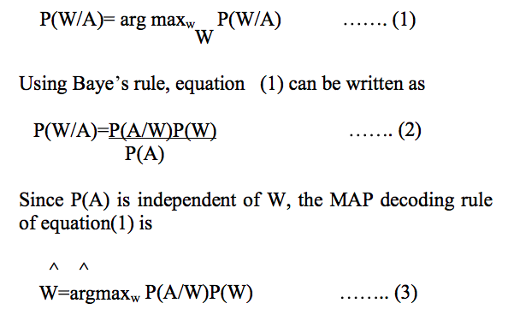
Anusuya, M. A., and Shriniwas K. Katti. "Speech recognition by machine, a review." arXiv preprint arXiv:1001.2267 (2010).
Khilari, Prachi, and V. P. Bhope. "A review on speech to text conversion methods." International Journal of Advanced Research in Computer Engineering & Technology 4.7 (2015).
Notes:
The first term in equation (3) P(A/W), is generally called the acoustic model, as it estimates the probability of a sequence of acoustic observations, conditioned on the word string. Hence P(A/W) is computed.
For large vocabulary speech recognition systems, it is necessary to build statistical models for sub word speech units, build up word models from these sub word speech unit models and then postulate word sequences and evaluate the acoustic model probabilities via standard concatenation methods
The second term in equation (3) P(W), is called the language model. It describes the probability associated with a postulated sequence of words.

Slide 9
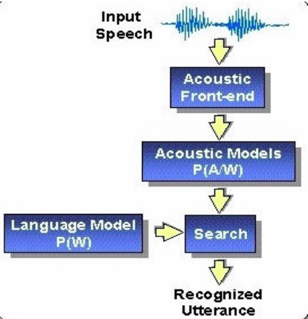
P(A/W), is generally called the acoustic model
P(W), is called the language model
Anusuya, M. A., and Shriniwas K. Katti. "Speech recognition by machine, a review." arXiv preprint arXiv:1001.2267 (2010).

Slide 10
Advantages
Supports Continuous Speech recognition
Anusuya, M. A., and Shriniwas K. Katti. "Speech recognition by machine, a review." arXiv preprint arXiv:1001.2267 (2010).
Khilari, Prachi, and V. P. Bhope. "A review on speech to text conversion methods." International Journal of Advanced Research in Computer Engineering & Technology 4.7 (2015).

Slide 11
Disadvantages
Doesn’t support Spontaneous Speech recognition.
May have more WER than other models.
Anusuya, M. A., and Shriniwas K. Katti. "Speech recognition by machine, a review." arXiv preprint arXiv:1001.2267 (2010).
Khilari, Prachi, and V. P. Bhope. "A review on speech to text conversion methods." International Journal of Advanced Research in Computer Engineering & Technology 4.7 (2015).

Slide 12
Application of prosody modiﬁcation for Speech
Recognition in different Emotion conditions
Analyze the performance of Automatic Speech Recognition (ASR) in different emotional environments using prosody modiﬁcation.
The ASR system performance can be improved in three different levels namely preprocessing level , robust feature representation level and model-based adaptation level
Prosody modification is done at the preprocessing level to convert the emotional utterance into neutral utterance, and the MFCC features are extracted later for ASR system.
[2] “Application of prosody modiﬁcation for Speech Recognition in different Emotion conditions”,V. V. Vidyadhara Raju, P. Gangamohan, Suryakanth V Gangashetty, and Anil kumar Vuppala

Slide 13
The prosody features of the source emotional utterances are modiﬁed according to the target neutral utterances using Flexible Analysis Synthesis Tool (FAST)
Dynamic Time Warping (DTW) is used to align the source emotional and target neutral utterances.
In this study, three emotions (compassion, happiness and anger) are considered for the analysis.
“Application of prosody modiﬁcation for Speech Recognition in different Emotion conditions”,V. V. Vidyadhara Raju, P. Gangamohan, Suryakanth V Gangashetty, and Anil kumar Vuppala

Slide 14
DISADVANTAGES
Database is considered where the speaker has uttered the same text in 7 different emotions along with neutral mode. This is the major limitation in using FAST.
FAST always require the target utterance to perform the conversion from source utterance. In real time, the study is limited as the target utterance is not available to perform the prosody modification.
The database used is a limited vocabulary.
“x

Slide 15
SUPPORT VECTOR MACHINE(SVM)
powerful tools for pattern recognition that uses a discriminative approach
It is a generalized linear classifier with maximum-margin fitting functions.
SVM controls the model complexity by controlling the VC dimensions of its model
ADVANTAGES
This method is independent of dimensionality and can utilize spaces of very large dimensions spaces.
By shifting all non-linearity to the features, SVM can use linear model for which VC dimensions is known.
[3] R.K.Moore, “Twenty things we still don t know about speech” Proc.CRIM/ FORWISS Workshop on Progress and Prospects of speech Research an Technology , 1994.

Slide 16
DISADVANTAGES
SVMs can only classify fixed length data vectors, this method cannot be readily applied to task involving variable length data classification
R.K.Moore, “Twenty things we still don t know about speech” Proc.CRIM/ FORWISS Workshop on Progress and Prospects of speech Research an Technology , 1994.

Slide 17
OUTLINE
Introduction
Literature Survey
Proposed System
Future works
Conclusion

Slide 18
System Layout
Voice to Text System
Query analyser
Response Generator
Text to Voice System

Slide 19
Deep Speech
Deep Learning for processing.
Recurrent Neural Networks
Improved Accuracy(81.1% compared to 69.5%)
[4] Hannun, Awni, et al. "Deep speech: Scaling up end-to-end speech recognition." arXiv preprint arXiv:1412.5567 (2014).

Slide 20
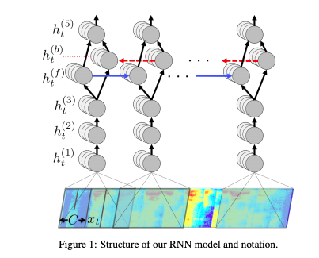
Hannun, Awni, et al. "Deep speech: Scaling up end-to-end speech recognition." arXiv preprint arXiv:1412.5567 (2014).
Notes:
Let a single utterance x and label y be sampled from a training set X = {(x (1), y(1)),(x (2), y(2)), . . .}. Each utterance, x (i) , is a time-series of length T (i) where every time-slice is a vector of audio features, x (i) t , t = 1, . . . , T(i) .
x (i) t,p denotes the power of the p’th frequency bin in the audio frame at time t. The goal of our RNN is to convert an input sequence x into a sequence of character probabilities for the transcription y, with yˆt = P(ct|x), where ct ∈ {a,b,c, . . . , z,space, apostrophe, blank}.
“3 non recurrent layers 4th has a forward and a backward feed layer
The output of forward and backward is fed to layer 5

Slide 21

N-gram language model
Huge Corpus trained language model to process language conditions
Hannun, Awni, et al. "Deep speech: Scaling up end-to-end speech recognition." arXiv preprint arXiv:1412.5567 (2014).

Slide 22
Optimization
Data parallelism- N matrix calculation of data
Model parallelism- Half Precision data sharing(forward and Backward)
Striding- 2 Step movement
Hannun, Awni, et al. "Deep speech: Scaling up end-to-end speech recognition." arXiv preprint arXiv:1412.5567 (2014).

Slide 23
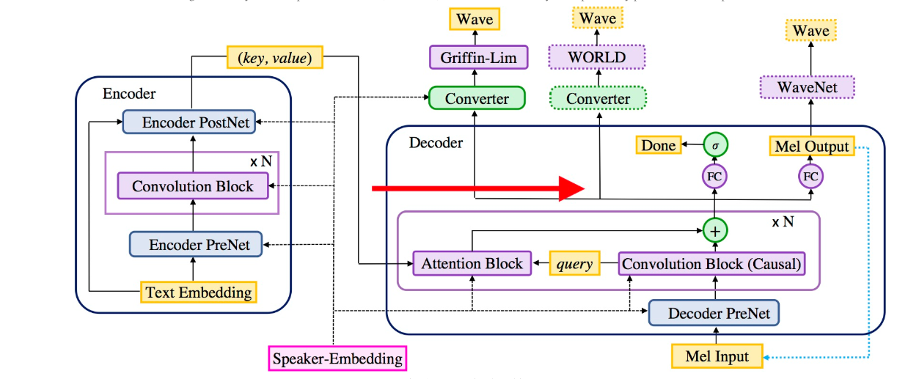
Deep Speech 3 for Speech Synthesis
[5] Ping, Wei, et al. "Deep voice 3: Scaling text-to-speech with convolutional sequence learning." (2018).

Slide 24
• Encoder: A fully-convolutional encoder, which converts textual features to an internal learned representation.
• Decoder: A fully-convolutional causal decoder, which decodes the learned representation with a multi-hop convolutional attention mechanism into a low-dimensional audio representation (mel-scale spectrograms) in an autoregressive manner.
• Converter: A fully-convolutional post-processing network, which predicts final vocoder parameters (depending on the vocoder choice) from the decoder hidden states. Unlike the decoder, the converter is non-causal and can thus depend on future context information.
Ping, Wei, et al. "Deep voice 3: Scaling text-to-speech with convolutional sequence learning." (2018).

Slide 25
OUTLINE
Introduction
Literature Survey
Proposed System
Future works
Conclusion

Slide 26
Future Works
Works | Timeline
Completing the Technology Survey and choosing appropriate models | 15 November 2018
Building the Model | 15 December 2018
Collecting Datasets (including manual dataset creations) | 15 December 2018
Training and Re-Modelling | 15 January 2018
Improvising | 15 February 2018

Slide 27
OUTLINE
Introduction
Literature Survey
Proposed System
Future works
Conclusion

Slide 28
Conclusion
We propose a system where the input is taken and processed through a GMM with RNN Network then the output is processed by a Query processing system based on NLP.
The output generated is then processed through the deepspeech model to generate output speech.

Slide 29
Rererences
[1] “Anusuya, M. A., and Shriniwas K. Katti. "Speech recognition by machine, a review." arXiv preprintarXiv:1001.2267 (2010).Khilari, Prachi, and V. P. Bhope. "A review on speech to text conversion methods." International Journal of Advanced Research in Computer Engineering & Technology 4.7 (2015).
[2] “ Application of prosody modiﬁcation for Speech Recognition in different Emotion conditions”,V. V. Vidyadhara Raju, P. Gangamohan, Suryakanth V Gangashetty, and Anil kumar Vuppala
[3] R.K.Moore, “Twenty things we still don t know about speech” Proc.CRIM/ FORWISS Workshop on Progress and Prospects of speech Research an Technology , 1994.
[4] Hannun, Awni, et al. "Deep speech: Scaling up end-to-end speech recognition." arXiv preprint arXiv:1412.5567 (2014).
[5] Ping, Wei, et al. "Deep voice 3: Scaling text-to-speech with convolutional sequence learning." (2018)

Slide 30
Any Queries?

Slide 31
Thank You

